Slide 1
Strengthening Your Local Organization
2015 LO Presidents Academy
Marco Hotel, CDO City
October 7, 2014

Slide 2
Your Local Organization
Task:
List as much Issues, Problems and Challenges of your Local Organization
Use One Post it Note each and post on the designated Wall
Teamwork
-5 minutes-

Slide 3
Strengthening Your Local Organization
Chapter Management and Administration
Recruitment and Retention
Chapter Meetings

Slide 4
CHAPTER MANAGEMENT & ADMINISTRATION
Beep Tan
2010 NTD - 2009 RVP – NL - 2004 Training Chair
2003 LO President ( Dagupan Bangus )

Slide 5
Management
is the function that coordinates the efforts of people to accomplish goals and objectives using available resources efficiently and effectively
Comprises Planning, Organizing, Leading and Controlling a group to accomplish a goal.

Slide 6
Chapter Management & Administration
BUDGET &
SPONSORSHIP
MEETINGS
STRATEGIC
PLANNING
MEMBERSHIP
PROTOCOL
CONSTITUTION
PROJECTS
OFFICERS

Slide 7
Chapter Management and Admin
Purpose ( the reason )
Constitution
Officers / Board of Directors
Project Planning
Budget and Sponsorships

Slide 8

Where to start?
Finding the Reason

Slide 9
Is JCI training organization?
“No, JCI is not primarily a training organization. Our main objective is to create a positive change through better-trained people.”
Notes:
9

Slide 10
Is JCI community service organization?
“No, JCI not basically a community service organization. Our objective is to create a positive change in our communities through our projects and services to the community.”
Notes:
10

Slide 11
Measurement of Success
Profit Industry
Non-Profit Industry
The only true measurement of success is HOW THEY FULFILL THEIR MISSION
Notes:
11

Slide 12
Measurement of Success
“To provide development opportunities that empower young people to create positive change.”
Notes:
12

Slide 13


Slide 14
2. CONSTITUTION
Legal document
Defines how the LO will be governed
Rights, Responsibilities and Liabilities
Regulate major issues

Slide 15
Constitution Content:
Name of the organization
Mission and principles
Who is eligible for membership
How it will be governed
The authorities
How they are elected
How it will be financed
Methods of amending it
Must be in line with National Organization and JCI

Slide 16

Policy Manual
Regulates the details of day to day work
How meetings will be conducted
How reports should be presented
How activities can be carried out
How the performance of officers should be evaluated
Any other rule not considered an article or bylaw of the Constitution

Slide 17
3. Board of Directors
Urgent decisions are made
Not always possible for members to meet
Elected by the members to represent on their behalf
Main purpose – to SERVE
Does not RULE
Does not have total Authority

Slide 18
Providing Opportunities
The essence of a Local Organization is to constantly provide opportunities.
Past officers must give way for new members to acquire experience.
Experienced members should move on to new challenges.

Slide 19
Succession Plan
Starts at the beginning of the year.
Ensures more candidates than positions.
Learn skills and get experiences for the position before taking over.
Involve your successor for an easy transition.
Helps consistency for the future.
Opportunities for members to become leaders.

Slide 20
The Role of the Board of Directors
Cannot plan only their own year.
The organization does not work on a yearly basis.
Must plan the success of the next Board.
At every meeting they must evaluate the progress of the next officers.
If there is a bad year, blame the previous Board of Directors.

Slide 21
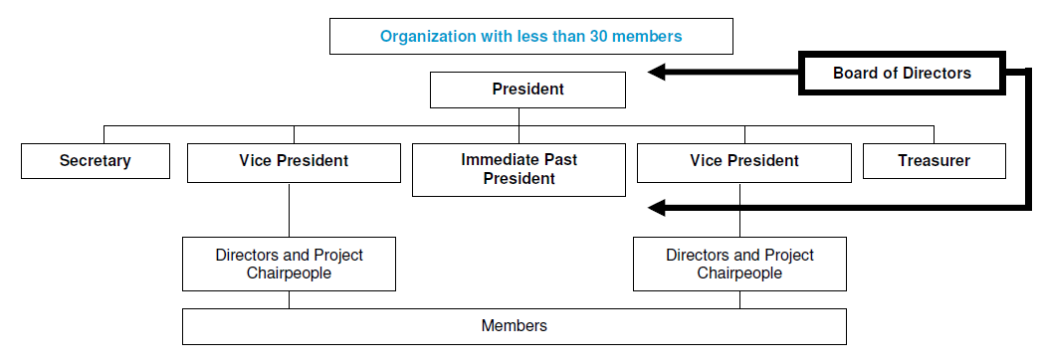
Sample Organizational Structure

Slide 22
Local Organization Structure
No ideal structure to fit all Local Organizations
One person should not supervise more than five
Balanced workload in Board
Flexibility to allow more or less activities
Delegation of responsibility and authority
Easy two-way communication
Clear expectations

Slide 23
Leadership Ladder
Your local structure should provide natural steps to grow in leadership…

Slide 24
4. Project Planning
What is a Project?
Is a means of solving a Problem
What is Planning?
Step by step guide to a project

Slide 25
Have a PLAN (of ACTION)
“If you fail to plan, you plan to fail”

Slide 26
The Plan of Action
The Mission
Key Activity Areas.
Objectives in each Area.
Strategies to achieve each objective.
Action Steps in each strategy

Slide 27
Characteristics of a good plan
Organized.
Fulfills needs.
Offers opportunities
Is achievable
Is simple
Is clear, specific.
Is flexible
Has a balanced program
Is well financed
Is complete

Slide 28
Murphy’s Laws:
If something can go wrong, it will.
Nothing is as simple as it looks.
Everything costs more money than you actually have.
If you explain something very clearly for everyone to understand, there will always be someone who did not.

Slide 29

JCI Project Planning Process:
Survey
Analysis
Planning
Action
Evaluation

Slide 30
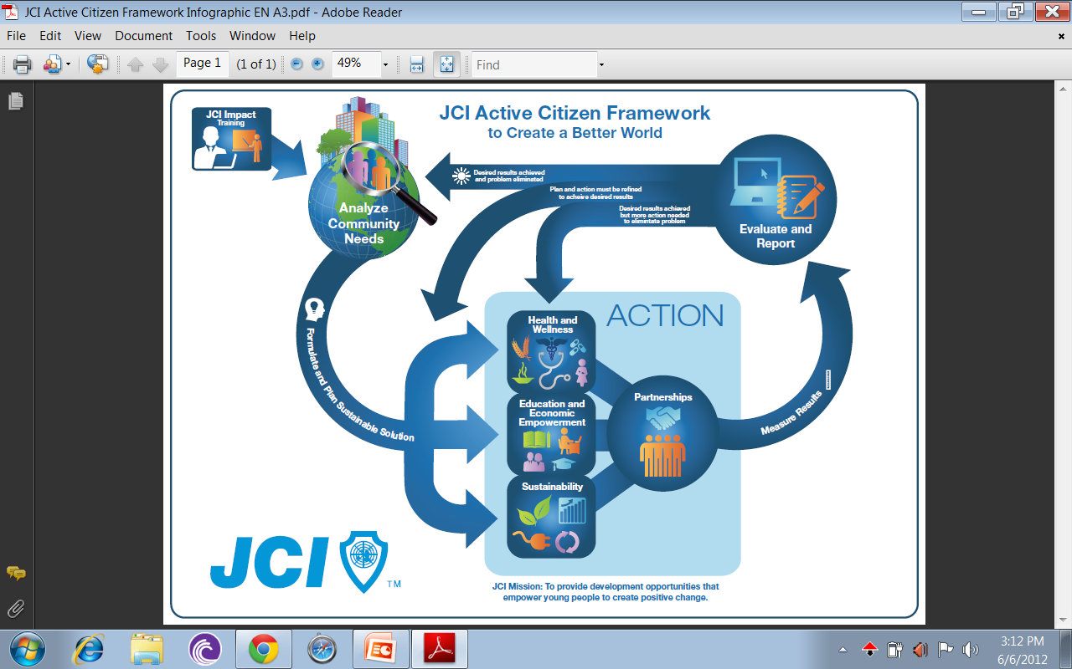

Slide 34
Implementing the Plan
Promote the Plan.
Select the right people.
Supervise.
Review.

Slide 35

The Secrets of Success
There are no Secrets of Success.
It is the result of preparation, hard work and learning from failure

Slide 36
4. Budget and Sponsorships
Administration costs must be covered by the dues and secured income.
Sponsorship only for specific programs.
All programs must have approved budget.
Budget must be approved by General Assembly.
Reports must be presented often.

Slide 37
Budget implementation steps
Preparation: Board and Directors estimate expenses.
Approval: General Assembly approves proposal from Board.
Review: Monthly report, projections and adjustments.
Records: For legal and transparency reasons.

Slide 38
Sponsorship & Donations
Not all projects have a sponsorship appeal.
For example, handing out clothing or food for the poor can be a great initiative but will not receive much sponsorship.
Donations may be the solution for administrative and project expenses.

Slide 39
Approach for Donations
Return benefits from JCI: Past members.
“Your contribution can help others to reach your success”
Charity: Some people just donate money.
“With your contribution we can continue providing opportunities”
Pressure: A supplier or a good friend.
“I need you to help me with a donation”

Slide 40
Approach for Sponsorship
Investment & return:
The project must get great media attention to get exposure for the sponsor’s brand.
Direct sales at a public event organized by the Local Organization.
Association of the brand to a good cause.

Slide 41
Approach for Sponsorship
Exchange for benefits:
When the need is not money, but something the sponsor can provide in return for other benefits
Could be services, support, products, venues, etc.

Slide 42
Learning from Others
A S K

Slide 43
Let’s A S K
Task:
In your teams, stand up and go to the designated chart and read the contents of the notes.
Write on post-it notes possible solutions for the listed problems
Teamwork

Slide 44
Discussion
Was it difficult to give solutions?
What did you notice about the charts?
Are the solutions simple?
Did you see your Local Organization
in the other charts?

Slide 45

Its all in the manner of ASKing
A
S
K
attitude
kills
nowledge

Slide 46

Application…………
Positive Attitude
Commitment
JCI is not a ONE MAN show – It is a shared responsibility
Being involved
Repetition and Consistency

Slide 47


The answer is …

Slide 48


THANK YOU
beep_tan@yahoo.com

Slide 49
Your Local Organization
Task:
Visit the Charts
Use One Post it Note each and post on the designated Wall
Teamwork

Slide 50
7+5=11
5 + 2 = 7
3+3 = 6
7 x 2 = 15
12+1= 13
11+11=22
8+8=16

Slide 51
Thank You
JCI Sen. Beep Tan
Notes:
To use this particular slide more than once in your presentation you must first copy and paste it because it is not a master and simply selecting new slide will not make it appear again.
Once you have done this follow the steps listed below to add a new picture that is relevant to your presentation:
1. Click anywhere on the black box so it is highlighted
2. Then ‘right click’ on it and choose – ‘send backward’ from the ‘order’ menu
3. Next, click on the photo of Zsolt and hit ‘delete’ on your keyboard
4. Now, using the Insert menu at the top, insert a picture onto the slide
5. Size your picture to fit approximately over the space of the white spaces in the black box – make sure your picture is not larger than the black box or you will see it.
6. When you are happy with the size of the photo, right click on your picture and choose ‘send backward’ from the ‘order’ menu.
*The picture should now be showing only in the white spaces of the black box. If this is not the case, repeat step 6
7. If it still doesn’t work – try again from the beginning
IMPORTANT NOTE: The slide is arranged so that the white spaces and black box are one image. Using the transparency tool we have turned the white color transparent allowing for any image under it to show through.

